Slide 1
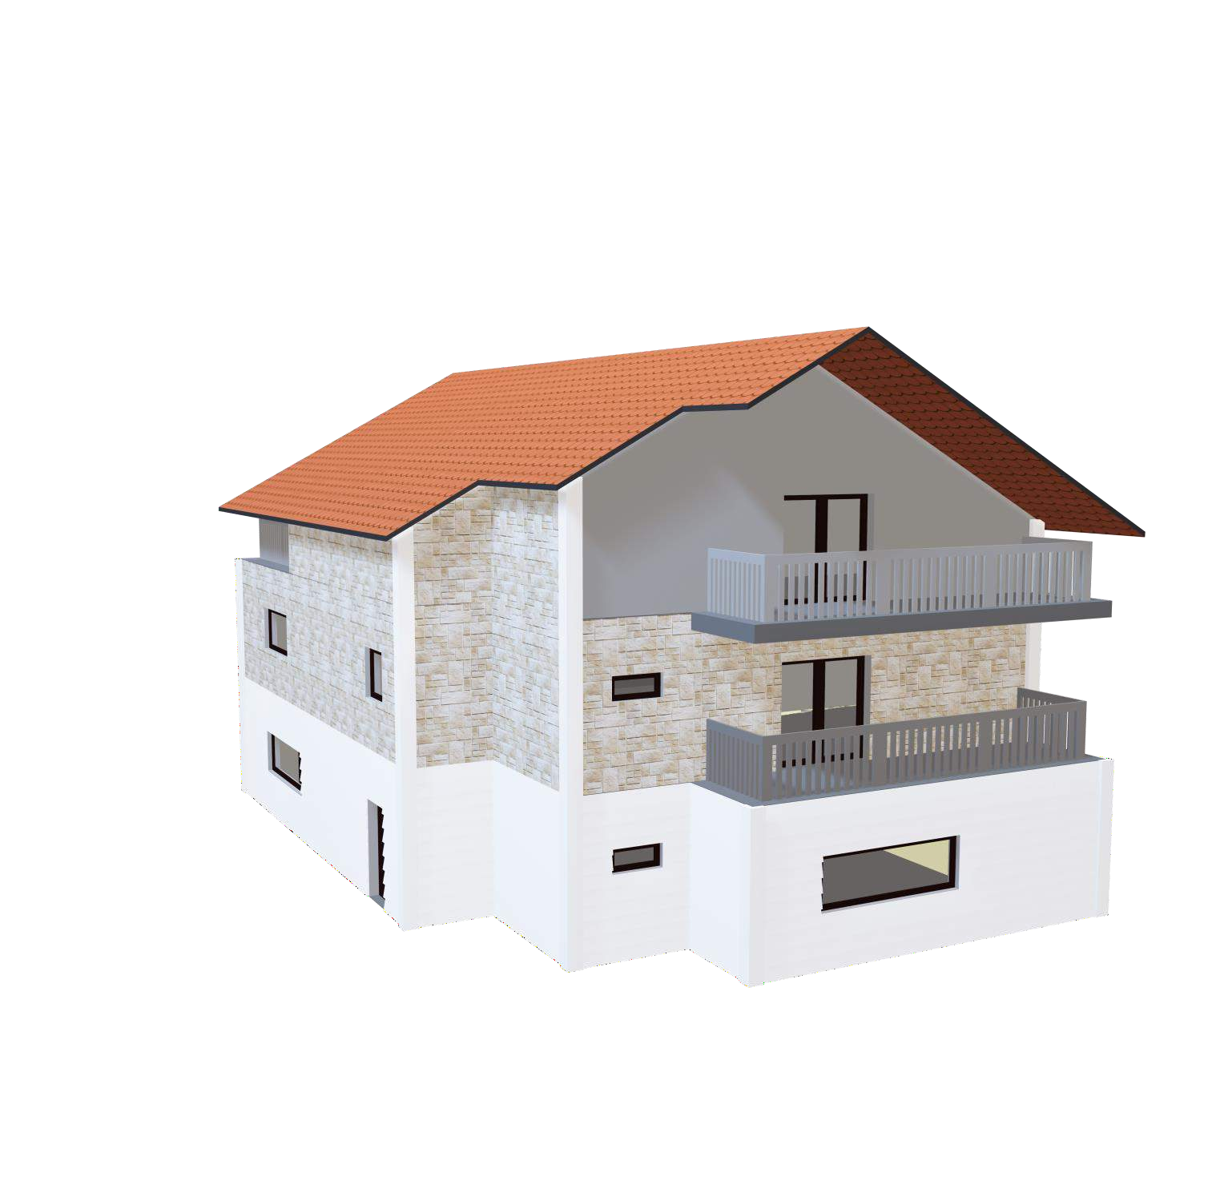
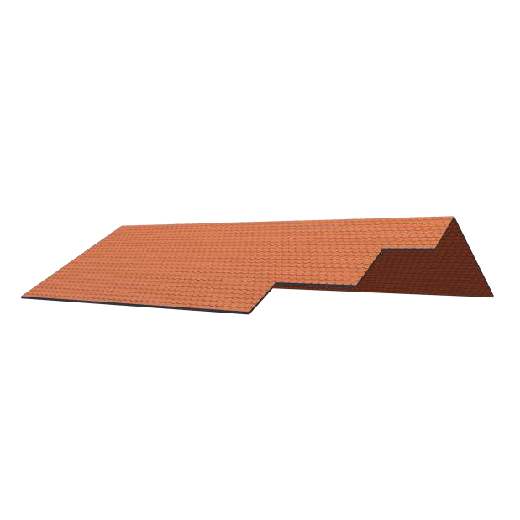
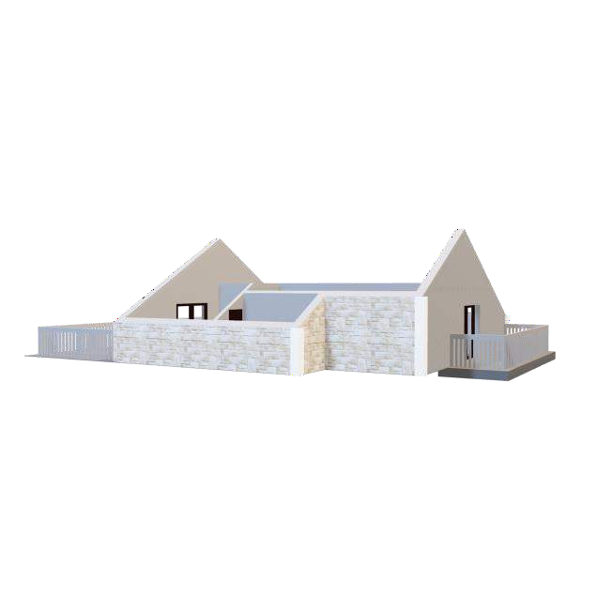
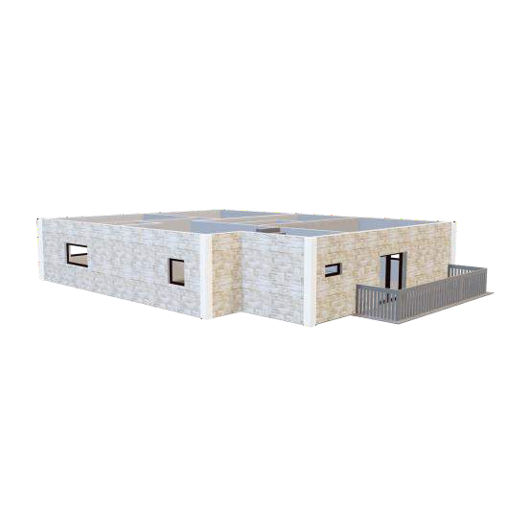
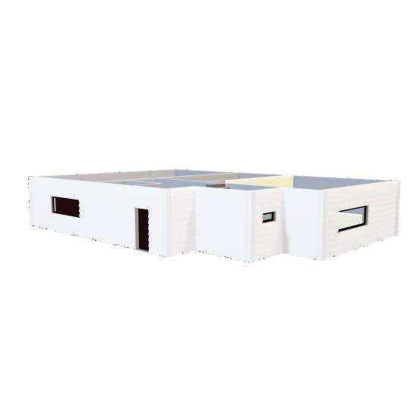
Surprise Housing Price Prediction Project
A case study from US-based housing company named “Surprise Housing”. The company is looking at prospective properties to buy houses at a price below their actual values and flip them at a higher price which will help the company to enter the real estate market.
PRESENTATION
Submitted by Mehul Bisht
Data Science Intern
Flip Robo Technologies

Slide 2
ACKNOWLEDGMENT
I would like to express my deepest gratitude to my SME (Subject Matter Expert) Sapna Verma as well as Flip Robo Technologies who gave me the opportunity to do this project on Surprise Housing Price Prediction, which also helped me in doing lots of research wherein I came to know about so many new things.
Also, I have utilized a few external resources that helped me to complete the project. I ensured that I learn from the samples and modify things according to my project requirement.

Slide 3
INTRODUCTION
Surprise Housing is a US based Real estate and housing company who is trying to entry into Australian Real estate market. The company is looking at prospective properties to buy houses to enter the market. We are required to build a model using Machine Learning in order to predict the actual value of the prospective properties and decide whether to invest in them or not.
For this Surprise Housing wants to know:
Which variables are important to predict the sale price of house?
How do these feature variables describe the price of the house?

Slide 4

AGENDA
Analytical Problem Framing
Exploratory Data Analysis (EDA)
Visualizations
Data Pre-Processing on train and test datasets
Model/s Development and Evaluation
Performing hyper parameter tuning, saving the best model and predicting the label
Conclusion and future work discussion

Slide 5

Hardware - Software Requirements and Tools Used
Hardware Used:
RAM: 8 GB
CPU:11th Gen Intel® Core™ i5-113567 @ 2.40 Ghz
GPU: Intel® Iris® Xe Graphics

Slide 6

Hardware - Software Requirements and Tools Used
Software Used:
Programming language: Python
Distribution: Anaconda Navigator
Browser based language shell: Jupyter Notebook
Libraries/Packages Used:
Pandas, NumPy, matplotlib, seaborn, scikit-learn and pandas_profiling

Slide 7
PROBLEM STATEMENT
Houses are one of the necessary need of each and every person around
the globe and therefore housing and real estate market is one of the
markets which is one of the major contributors in the world’s economy. It
is a very large market and there are various companies working in the domain.
Data science comes as a very important tool to solve problems in the
domain to help the companies increase their overall revenue, profits,
improving their marketing strategies and focusing on changing trends in house sales and purchases.
Predictive modelling, Market mix modelling, recommendation systems
are some of the machine learning techniques used for achieving the
business goals for housing companies. Our problem is related to one such housing company.

Slide 8
ANALYTICAL PROBLEM FRAMING
As we are provided with two sets of data, one is for training and other for testing. Here we need to build a machine learning model using train dataset and then by using that model we will make predictions for test dataset.
Both the datasets are in csv format, train dataset has 1168 rows and 81 columns whereas test dataset has 292 rows and 80 columns. Here in the test dataset we do not have the target label and need to predict the same.
And as we have to predict house sale prices in this problem which is a continuous data, I will be using different regression machine learning models.

Slide 9
DATA ANALYSIS - MODEL BUILDING
FLOWCHART
Import Dependencies or Libraries
Data set
Collection
Data preprocessing
Checked for Null
Values
Encoding
EDA and Visualization
Checked for correlation
Proceed for
Model building
Checked for
Outliers/Skewness
R2 Score, Cross Validation Score, MSE, RMSE, MAE
Saving the
Final_Model
Hyper Parameter
Tuning

Slide 10
DATA PRE PROCESSING
Importing the necessary dependencies and libraries.
Reading the CSV file and converted into data frame.
Checking the data dimensions for the original dataset.
Looking for null values and accordingly fill the missing data.
Checking the summary of the dataset.
Checking unique values.
Checking all the categorical columns in the dataset.
Visualizing each features using matplotlib and seaborn.

Slide 11
DATA PRE PROCESSING
Performing encoding using the ordinal encoder on categorical features.
Checking for co-relation/multi-collinearity in a heatmap.
Checking for Outliers/Skewness using boxen plot and distribution plot.
Perform Scaling using Standard Scaler method.
Checking for the final dimension of dataset to confirm the input details.
Creating train test split and the best random state found in the range 1-1000.

Slide 12
EXPLORATORY DATA ANALYSIS (EDA) AND VISUALIZATION
01. Univariate Analysis
02. Multivariate Analysis
03. Correlation of Dataset
Univariate analysis is the simplest form of analyzing data. “Uni” means “one”, so in other words your data has only one variable.
Multivariate analysis is a set of statistical techniques used for analysis of data that contain more than one variable.
Correlation is used to test relationships between quantitative variables or categorical variables.
04. Correlation with Target variable
05. Conclusion
Correlation with the target variable to know how the data is related.
Summary with the conclusion of all the analysis

Slide 13
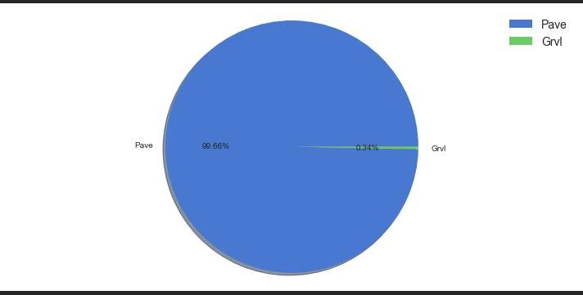
PIE PLOT
A Pie Chart is a circular statistical plot that can display only one series of data.
The area of the chart is the total percentage of the given data.
The area of slices of the pie represents the percentage of the parts of the data.

Slide 14
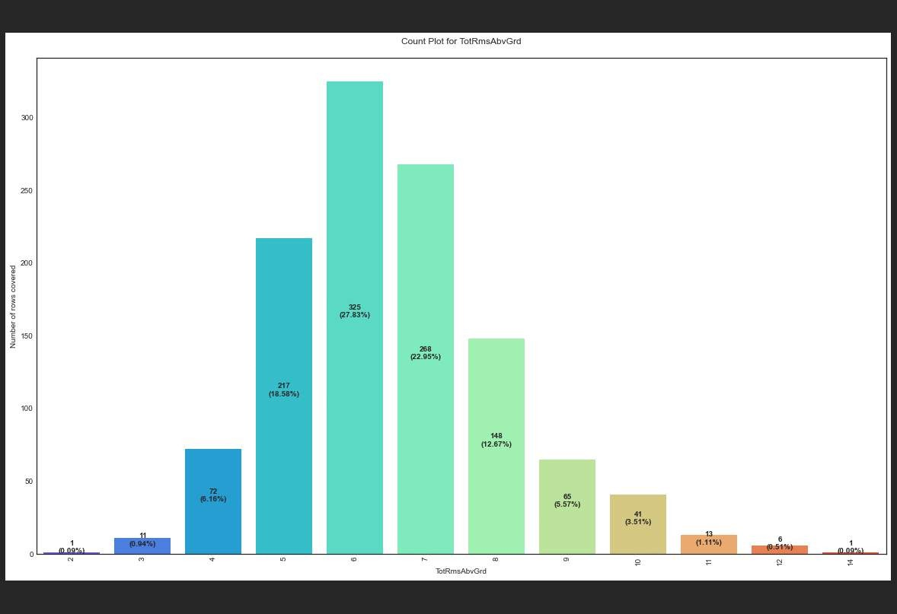
COUNT PLOT
Count plot method is used to show the counts of observations in each categorical bin using bars.
Parameters : This method is accepting the following parameters that are described below: x, y
This parameter take names of variables in data or vector data, optional inputs for plotting long- form data.

Slide 15
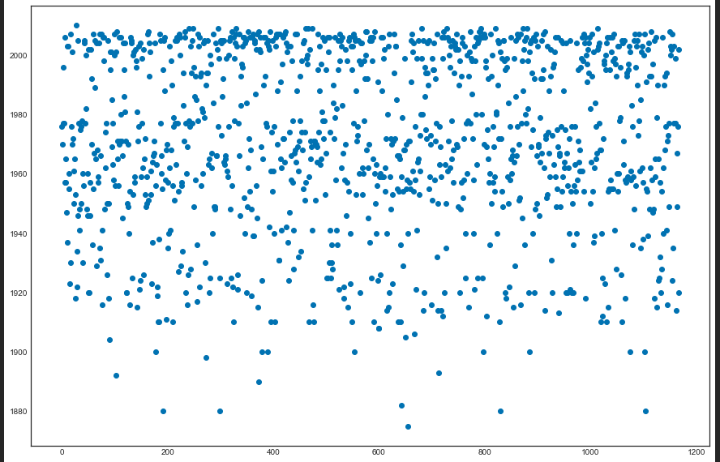
SCATTER PLOT
Scatter plots are used to observe relationship between variables and uses dots to represent the relationship between them.
The scatter method in the matplotlib library is used to draw a scatter plot.
Scatter plots are widely used to represent relation among variables and how change in one affects the other.

Slide 16
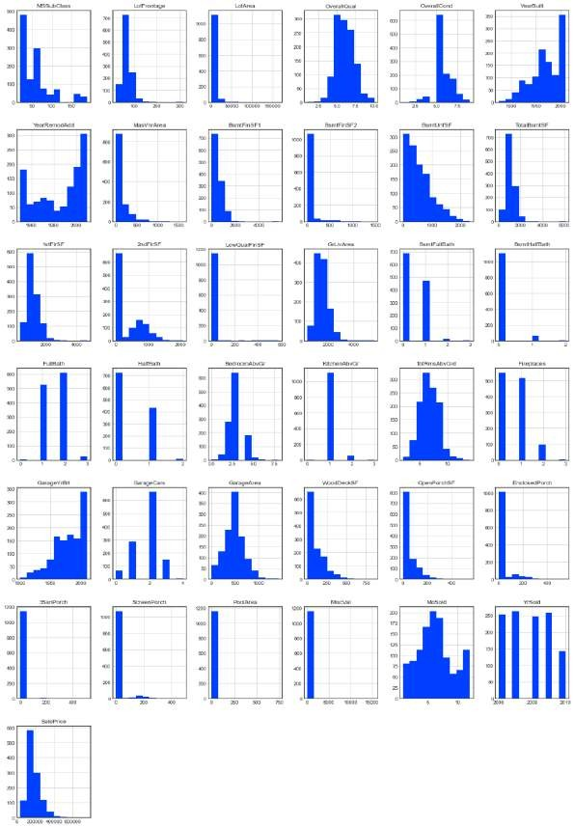
HISTOGRAM
A histogram is basically used to represent data provided in the form of some groups.
It is accurate method for the graphical representation of numerical data distribution.
It is a type of bar plot where X-axis represents the bin ranges while Y-axis gives information about frequency.

Slide 17
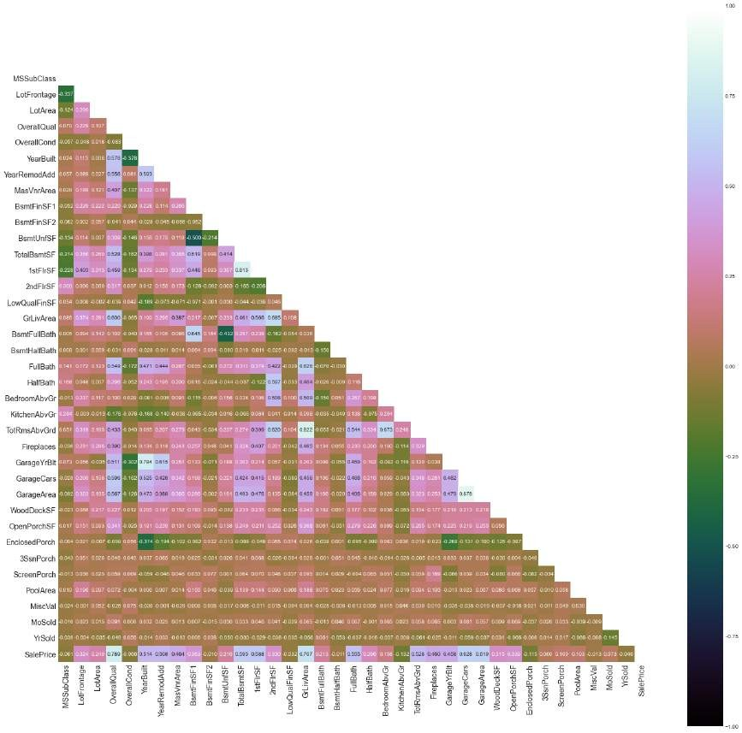
HEATMAP
A heatmap contains values representing various shades of the same color for each value to be plotted.
Usually the darker shades of the chart represent higher values than the lighter shade.
For a very different value a completely different color can also be used.

Slide 18
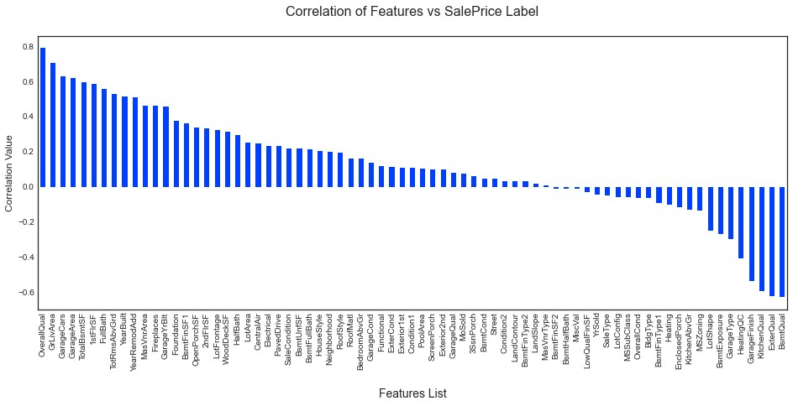
BAR GRAPH
Bar graphs are used to compare things between different groups or to track changes over time.
Here we are comparing the correlation values between the feature columns and the target label column which is Sale Price in our scenario.
It gives us an insight on positive and negative correlated column details.

Slide 19
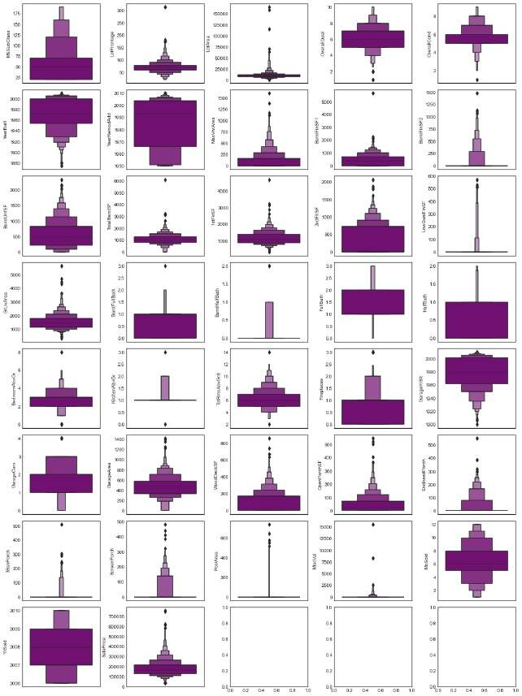
BOXEN PLOT
A Boxen Plot is also known as Whisker plot is created to display the summary of the set of data values having properties like minimum, first quartile, median, third quartile and maximum.
We have used it to identify the outlier details for all the numeric datatype column values.

Slide 20
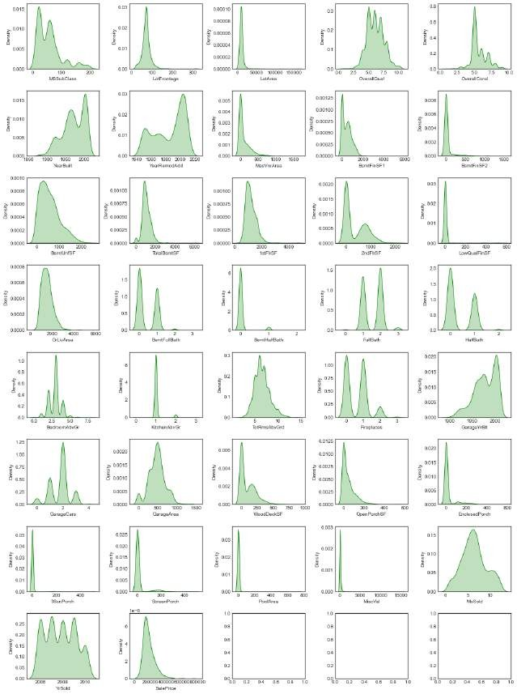
DISTRIBUTION PLOT
Distribution plots visually assess the distribution of sample data by comparing the empirical distribution of the data with the theoretical values expected from a specified distribution.
Here we have used it to analyze the skewness information for numeric datatype column values.
The acceptable form usually is a normal distribution resembling a bell shape curve.

Slide 21
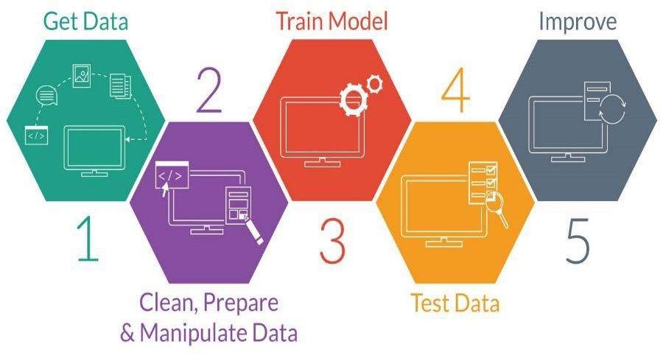
MODEL TRAINING PHASES

Slide 22
MODEL/S DEVELOPMENT
The algorithms used on training and test data are as follows:
Linear Regression Model
Ridge Regularization Regression Model
Lasso Regularization Regression Model
Support Vector Regression Model
Decision Tree Regression Model
Random Forest Regression Model
K Nearest Neighbors Regression Model
Gradient Boosting Regression Model
Ada Boost Regression Model 10.Extra Trees Regression Model

Slide 23
EVALUATION AND HYPER PARAMETER TUNING
The key metrics used here were:
R2 score
Cross Validation Score
MAE
MSE
RMSE
We tried to find out the best parameters list to increase our accuracy scores by using Hyperparameter Tuning.
In order to achieve a higher score we used the Grid Search CV method with 5 folds.

Slide 24
CONCLUSION AND SCOPE FOR FUTURE WORK
During this project I have faced a problem of low amount of data for training the machine learning models upon.
Many columns are with same entries in more than 80% of rows which lead to reduction in our model performance.
One more issue present is there are large number of missing values in this data set, so we have to fill those missing values in correct manner manually.
We can still improve our model accuracy with some feature engineering and by doing some extensive hyperparameter tuning on it.

